Slide 1
Imported Exclusively by Belgravia Imports, Inc.

Slide 2
Agenda
Our Story
Mocktails Brand On Trend
Market Data
Core Segments
Belgravia Imports – US Importer
belgravia@belgraviaimports.com  www.belgraviaimports.com 1.800.848.1127
CONFIDENTIAL

Slide 3
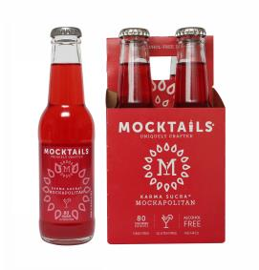
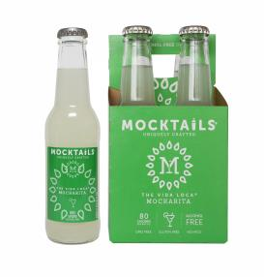
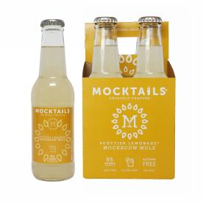
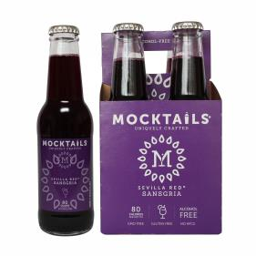
Our Story
Our families were searching for fun alternatives to alcohol, water & soda…
We wanted something delicious and uniquely crafted to be enjoyed with
food or to join the party anytime.
We searched, but found nothing suitable and healthier so we created
products: great tasting mixology inspired beverages for when you are not drinking, and a simple way to serve better-for-you cocktails for when you are…
From our families to yours.
Belgravia Imports – US Importer
belgravia@belgraviaimports.com  www.belgraviaimports.com 1.800.848.1127
CONFIDENTIAL

Slide 4
A Lifestyle Brand for Today’s Consumer
Belgravia Imports – US Importer
belgravia@belgraviaimports.com  www.belgraviaimports.com 1.800.848.1127
CONFIDENTIAL

Slide 5
On Trend
Mocktails Brand is on trend:
Non-drinkers do not want to be limited to simple water or chemically laden soft drinks
Cleaner and healthier food and beverages
More choice and customization
Convenience without sacrificing ingredients
Lower sugar premium offerings
Ready to drink or mix
Inclusive - Mixology for all
Belgravia Imports – US Importer
belgravia@belgraviaimports.com  www.belgraviaimports.com 1.800.848.1127
CONFIDENTIAL

Slide 6
Premium Beverages Are In
Made with the finest ingredients, exotic flavors, botanticals, and spices
Vegan
Ready to drink or mix
Less than 100 calories per bottle
Less sugar than sodas and similar mixers
Nothing Artifical
No HFCS
No Preservatives
No Fat, cholesterol or sodium
Gluten Free
BPA Free
Allergen Free
Belgravia Imports – US Importer
belgravia@belgraviaimports.com  www.belgraviaimports.com 1.800.848.1127
CONFIDENTIAL

Slide 7
How many consumers are we talking about?
1/3 of 220 million US adults choose not to drink alcohol 45% in any given month (CDC, USDA, Dept. of Justice).
Pregnant women, people on medications, in-season athletes, weight loss /health and wellness, allergy sufferers, religious abstainers, recovering addicts. and supportive family members, as well as designated drivers abstain.
60% of Americans age 18 & over consume half a drink or less a week (National Institute on Alcohol Abuse & Alcoholism, November 2014).
Fewer percentage of adult drinkers today vs 50 years ago (and 50 vs 100 years ago).
Women and Millennial generation are leading the trend.
non-drinkers
drinkers
Alcoholic vs Non-Alcoholic Drinkers (adults over 21 in the US in a given month)
Contributing Factors:
A changing relationship with alcohol.
Millennials and Liability are forcing the issue.
Soda sales are slumping due to health concerns.
Water is healthy for us but boring in social settings.
Expected that better alternatives to alcohol, soda, or
water be offered.
Frequency of drinking (adults 21 and over days per month)
Belgravia Imports – US Importer
belgravia@belgraviaimports.com  www.belgraviaimports.com 1.800.848.1127
CONFIDENTIAL

Slide 8
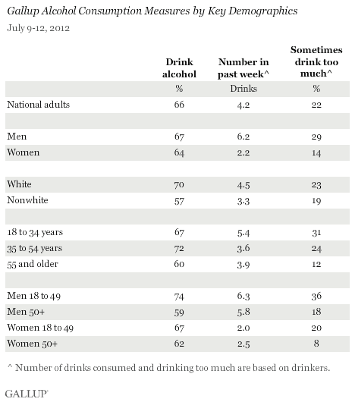
Critical Marketplace Data
A Nation Of Shrinking Drinkers: Who Wins And Who Loses As Booze Sectors Contract Mark Fritz Benzinga September 16, 2017
STYLE
Happy Hour Without the Booze
By RACHEL LEVIN JAN. 20, 2016
Health
Sober is the new drunk: why millennials are ditching bar crawls for juice crawls, is being sober finally trendy?
Angelina Chapin
Thursday 21 April 2016 08.00 EDT
The Decline of ‘Big Soda’
The drop in soda consumption represents the single
largest change in the American diet in the last decade.
By MARGOT SANGER-KATZOCT. 2, 2015
Gallup and AB estimate 1/3 of Americans do not drink alcohol
Belgravia Imports – US Importer
belgravia@belgraviaimports.com  www.belgraviaimports.com 1.800.848.1127
CONFIDENTIAL

Slide 9
The 45% Looking For A Difference
Pregnant &
Nursing Mothers
Health Kick
Designated Drivers
Just Don’t Feel like It Tonight
Those In Recovery And Their Supporters
Athletes
In Season/Training
Allergic To Alcohol
People On Medications
End Of Evening Transition
Never Acquired The Taste
Religious Abstainers
Belgravia Imports – US Importer
belgravia@belgraviaimports.com  www.belgraviaimports.com 1.800.848.1127
CONFIDENTIAL

Slide 10
Mega Trends Widening the Gap
Soda in decline
Juice in decline
Cocktail Resurgence while alcohol volume in decline
Experiential
Evolving Tastes
Health and Wellness
Millennials
Belgravia Imports – US Importer
belgravia@belgraviaimports.com  www.belgraviaimports.com 1.800.848.1127
CONFIDENTIAL

Slide 11
An Elegant Solution
Soda in decline
Juice in decline
Cocktail Resurgence Alcohol in decline
Experiential
Evolving Tastes
Health and Wellness
Millennials
Belgravia Imports – US Importer
belgravia@belgraviaimports.com  www.belgraviaimports.com 1.800.848.1127
CONFIDENTIAL

Slide 12
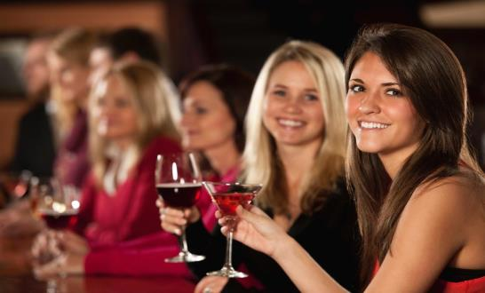
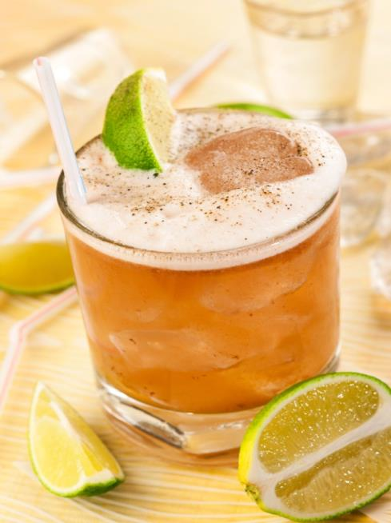
Core Customer Segments
The Thoughtful Host
Hotels, bars, restaurants, catering, at home hosts
Responsibility to provide attractive options
Serve Adult drinkers and non-drinkers alike
The Social Non-Drinker
Consciously opts (permanently or temporarily) for alcohol-free beverages
Seeking healthier, inclusive, adult beverages
Social settings from 2 to large functions
The Better-For-You Mixer
Tired of the ultra sweet, HFCS, cheap options
Seeking more authentic and healthier mixer
Social experience and quality
Convenience – ready to serve or mix
Belgravia Imports – US Importer
belgravia@belgraviaimports.com  www.belgraviaimports.com 1.800.848.1127
CONFIDENTIAL
12

